Slide 1
Jumbo & Company
Monthly Analysis
By: Hritik Shukla
Last updated: 14/12-2025

Slide 2
Objective
This analysis evaluates insurance attachment rates for 163 different sellers across six branch regions to identify performance patterns, understand regional variations, and provide actionable insights for strategic decision-making.
Key Objectives:
Benchmark and compare regional performance to identify top-performing branches
Analyze statistical significance of performance differences across regions
Segment stores into performance clusters for targeted interventions
Identify trends and forecast future attachment rates to support proactive planning
Through comprehensive data analysis and visualization, this report delivers evidence-based recommendations to optimize insurance sales effectiveness across all regions.

Slide 3
Table of Content
● Dataset Overview & Data Quality Notes
● Branch-Level Performance Benchmarking
● Performance Trends: High vs Lower Performing Branches
● Performance Variability & Consistency Analysis
● Store-Level Distribution & Outlier Detection
● Store Performance Classification (Quartile-Based)
● Regional Concentration of Performance Gaps
● Business Interpretation & Strategic Implications

Slide 4
Dataset Overview
Scope: 163 stores across 6 branch regions, tracking insurance attachment rates over 5 months
Overall Trend: Moderate improvement observed in early months, followed by stabilization, indicating improving sales effectiveness
Recent Performance: Growth has plateaued in the last 2 months, coinciding with reduced transaction volumes and increased performance variability (higher standard deviation)
Outlier Presence: Significant outliers detected with maximum attachment rates substantially exceeding the third quartile across regions
Data Quality Note: Some entries show 80-100% attachment rates but correspond to very low customer counts, requiring careful interpretation during analysis

Slide 5
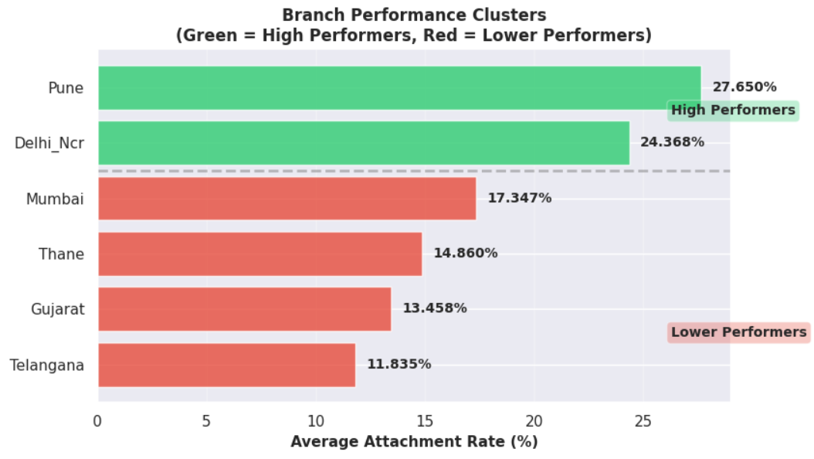
Two-Tier Performance Pattern: Distinct Leaders, Broad Lower Cluster
Top tier: Pune (27.7%) and Delhi_NCR (24.4%) form the high-performance cluster, converting approximately 1 in 4 customers
Bottom tier: Four branches (Mumbai, Thane, Gujarat, Telangana) range from 11.8% to 17.3%, converting only 1 in 7-8 customers
Performance gap: 12 percentage point difference between high and low performers represents an 81% effectiveness gap
Overall benchmark: Only 2 out of 6 branches (33%) exceed the company average of 18%, indicating significant improvement potential

Slide 6
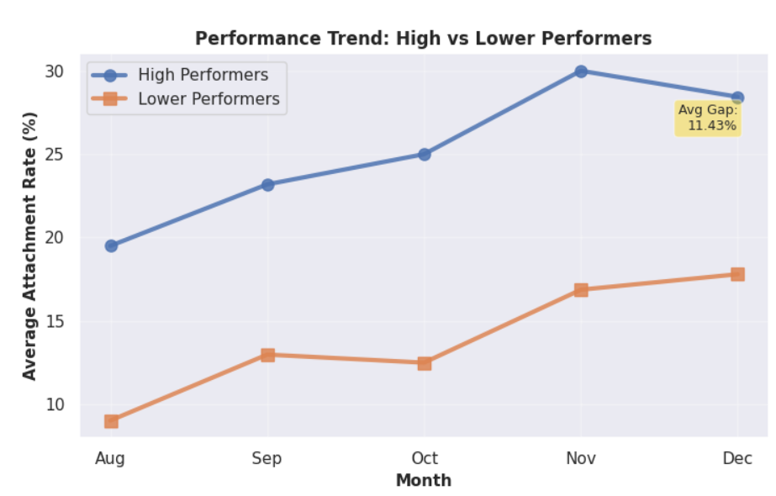
The Gap is Widening, Not Closing
Diverging trajectories: High performers improved from 19.5% (Aug) to 29.5% (Nov) before slight December decline, while lower performers grew modestly from 9% to 18%
Gap expansion: Performance differential increased from 10 percentage points (August) to 11.4 percentage points (December), showing the divide is growing
Consistency over time: High performers maintained leadership throughout all 5 months, proving this is systematic rather than seasonal variation
Momentum concern: Lower performers showed stagnation in Oct-Nov period while high performers continued strong growth, suggesting different growth capabilities
Observed trends are descriptive and do not imply causality.

Slide 7
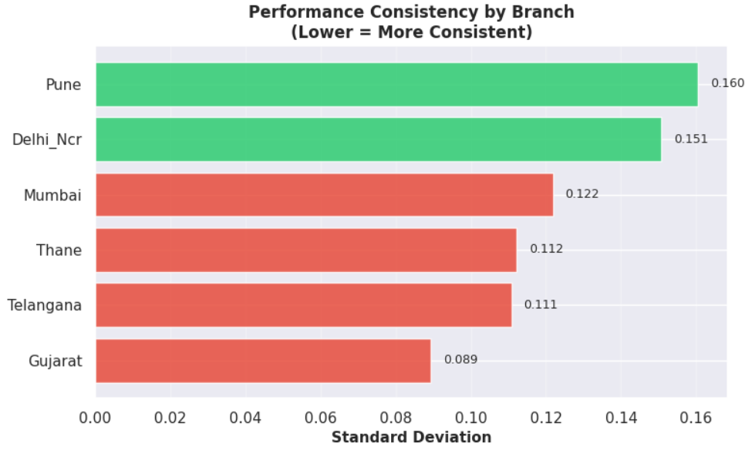
Paradox of Success: Top Performers Show Higher Variability
Higher averages, higher variability: Top-performing branches (e.g., Pune, Delhi_NCR) show strong average attachment rates but large store-level performance dispersion
Success driven by few stores: Branch-level strength is largely influenced by a subset of exceptional performers, not uniform execution
Lower performers are more consistent: Weaker branches exhibit narrower performance ranges, indicating consistent but suboptimal outcomes
Implication: Sustainable improvement requires scaling top-store best practices and reducing variability, not relying on outliers

Slide 8
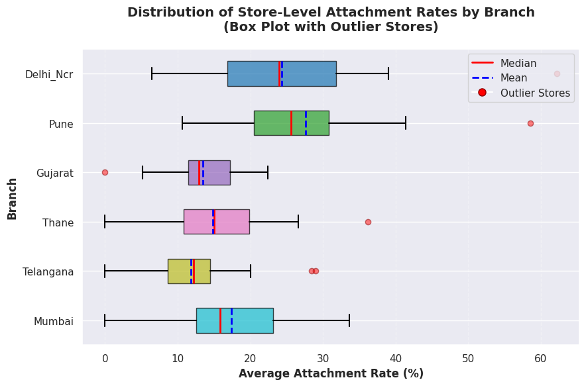
Understanding Performance Distribution and Outliers
Performance dispersion: Most branches exhibit wide performance spreads (~20–30 percentage points), highlighting significant store-level variability within regions.
Outlier identification: Six stores were identified as statistical outliers across branches, representing extreme cases that merit focused store-level review.
Distribution shape: Median (red) and mean (blue dashed) values are closely aligned for most branches, suggesting relatively symmetric distributions without strong skewness.
Consistency across branches: Interquartile ranges vary by branch—Gujarat and Telangana show tighter, more consistent performance, while Delhi_Ncr and Pune display higher variability.
Performance is balanced but polarized: 1 in 4 stores need urgent support.

Slide 9
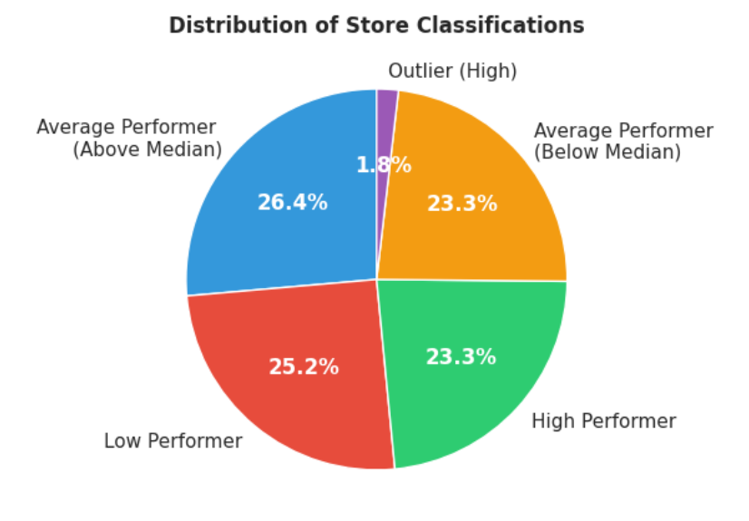
Overall Store Performance Distribution
Performance distribution: 25% of stores are classified as high performers, ~50% as average performers, and ~25% as low performers based on quartile-driven statistical classification.
Intervention scope: 41 stores (25%) identified as requiring immediate attention, indicating a focused and manageable improvement opportunity.
Success models: 41 stores (top quartile + positive outliers) act as internal benchmarks for best-practice replication.
Action priority: The classification framework enables targeted resource allocation—scaling proven practices from top performers while prioritizing intensive support for the bottom quartile.

Slide 10
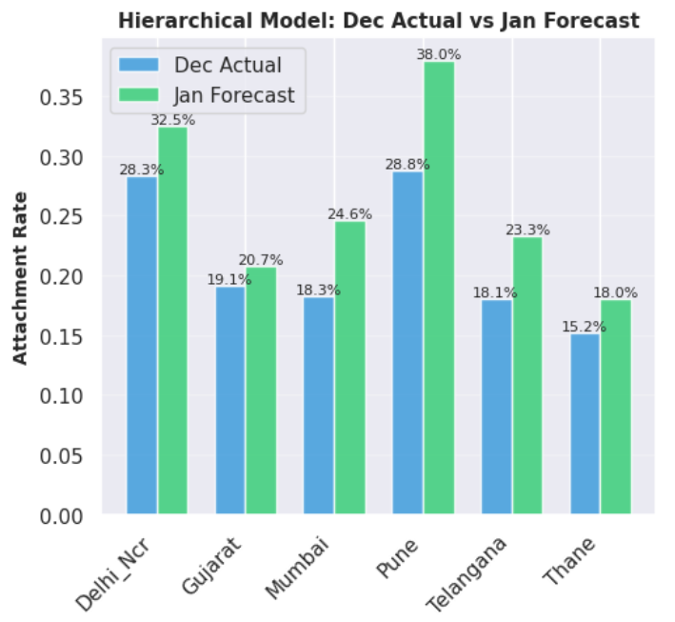
January Forecast - December Actual vs January Projected
Growth-led outlook: All 6 branches are forecasted to grow in January (+1.6% to +9.2%), indicating overall upward momentum.
Gap persists: Top branches (Pune, Delhi NCR) remain projected at 32–38%, while lower performers stay near 18–21%, showing limited natural convergence.
Localized risk remains: 23% of stores (38) show declining trends, primarily in Gujarat and Thane, requiring targeted intervention.
Directional confidence: Store-level confidence is limited, but branch-level signals (Avg R² ≈ 0.55) are strong enough to guide planning decisions.
Forecast based on hierarchical model combining store (60%) and branch (40%) trends using 5-month historical data with adaptive weighting.

Slide 11
The Core Problem & Opportunity
The Core Problem
Untapped upside: A 12 pp gap means lower performers operate at only ~55% of top-branch effectiveness
Systematic, not random: Branch location explains ~32% of performance variance (p < 0.000001)
Gap is widening: Performance spread increased ~20% over 5 months, favoring current leaders
The Opportunity
Proven, repeatable success: Pune & Delhi_NCR consistently achieve 26–28% attachment
High ROI lever: Closing 50% of the gap (14% → 20%) implies 40%+ revenue uplift in lagging regions
Execution is feasible: Limited set of high-risk stores and underperforming branches enables focused action
Key takeaway: The issue is structural, measurable, and solvable—not a market limitation.

Slide 12
Strategic Imperatives (90-Day Plan)
What Must Be Done
Immediate (0–30 days): Deep-dive Pune & Delhi_NCR playbooks
(training, incentives, scripts, store ops, team management)
Near-term (30–60 days): Pilot best practices in one underperforming branch with weekly tracking
Medium-term (60–90 days): Scale validated interventions to remaining low performers with central support
Ongoing: Monthly branch reviews with early-warning signals using forecast models
Objective: Reduce variance, replicate success, and prevent future divergence.

Slide 13
Statistical Validation: Why We Can Trust These Findings
Sample size: 163 stores × 5 months = 815 data points analyzed, providing statistically robust conclusions
ANOVA results: F-statistic = 14.54, p-value < 0.000001 confirms branch differences are real, not chance variation
Effect size: Branch location explains 31.65% of all performance variance—the single largest controllable factor identified
Confidence: 8 out of 8 cross-tier pairwise comparisons statistically significant (p < 0.05), confirming distinct performance clusters

